Slide 1
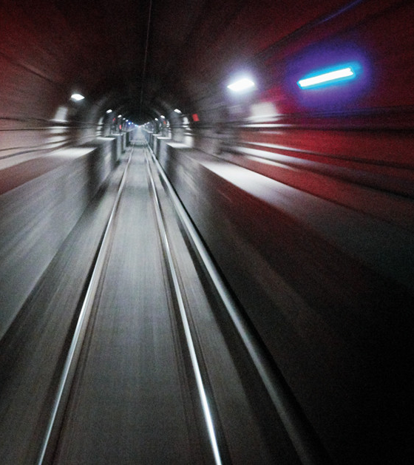
DETECTION OF OBJECTS IN A TUNNEL USING DEEP LEARNING
RITIKA AGARWAL

Slide 2
INTRODUCTION
A LiDAR scan was used in a tunnel- Tunnel Mont Royale located in Montreal, Canada of approximately 500metres which generated a large amount of point cloud data.
My aim was to identify the locations of different materials in this tunnel using the point cloud data which was converted to images.
To do this I Implemented a Object Detection algorithm called YOLO - Darkflow

Slide 3
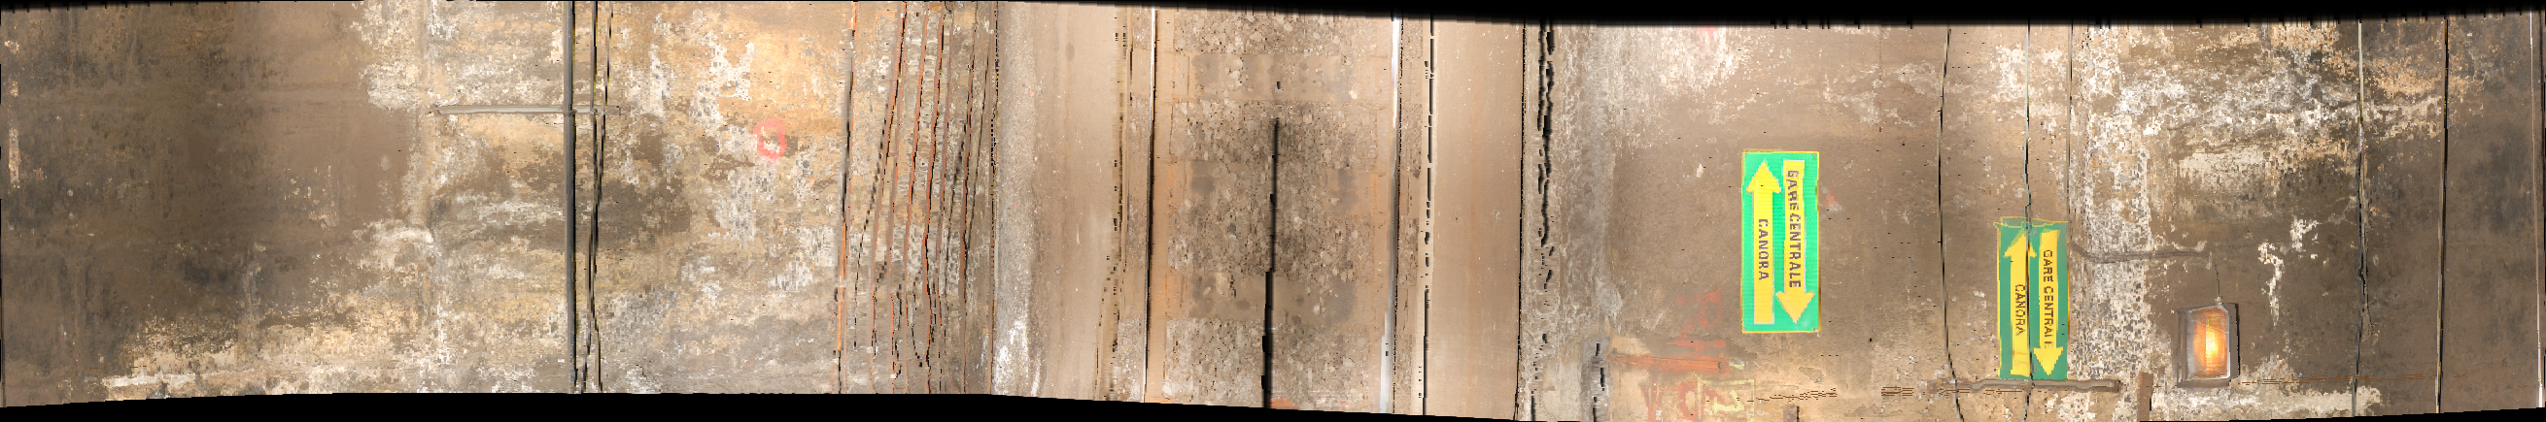
ABOUT THE DATA
POINT CLOUD INFORMATION
DATA contains : X,Y,Z,RGB
Dataset size: 203
pipes: 1203
sign: 105
light: 24
tracks: 230
green cables: 17

Slide 4
METHODOLOGY
Labeling the data
Setup the environment
Download and adapt the code
Train and Visualize
Transforming data
Choosing an algorithm

Slide 5
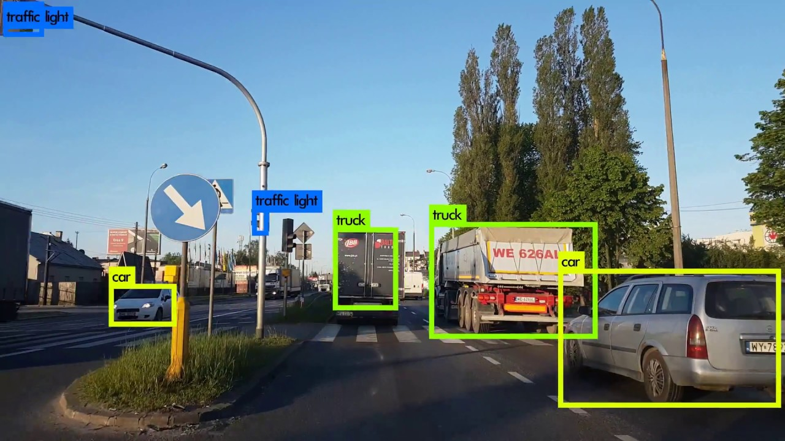
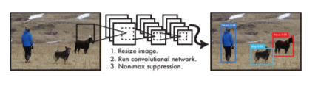
OBJECT DETECTION
Object detection is the task of identifying objects in an image and drawing bounding boxes around them, i.e. localizing them
YOLO is a popular algorithm because it achieves high accuracy while also being able to run in real-time.
It provides state-of-the-art the best tradeoff between real-time speed and excellent accuracy for object detection
3 implementations of Yolo- I chose Darkflow

Slide 6
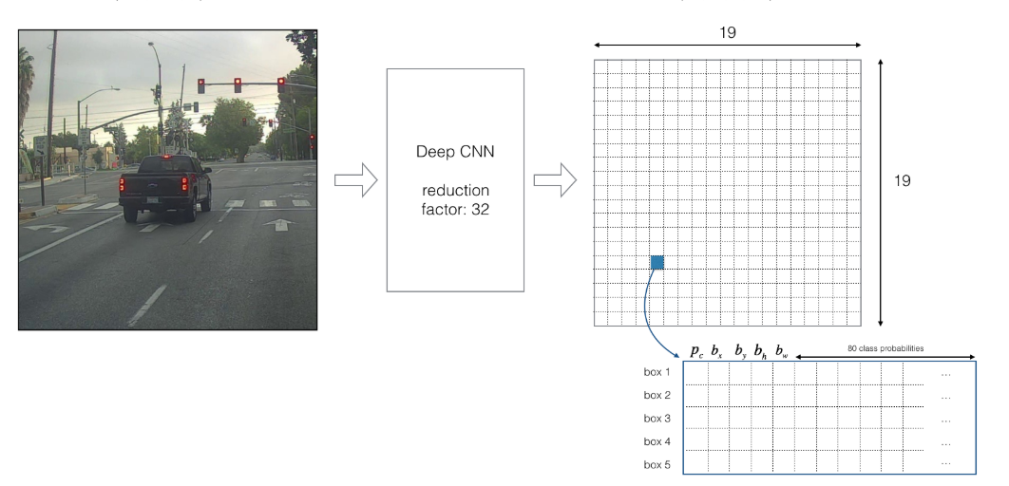
YOLO

Slide 7
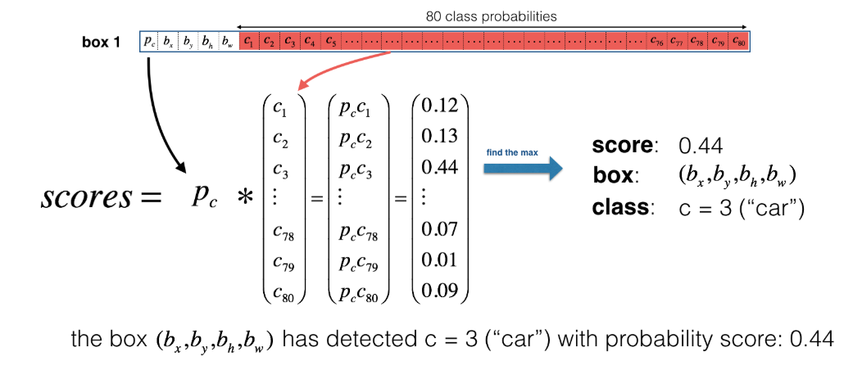
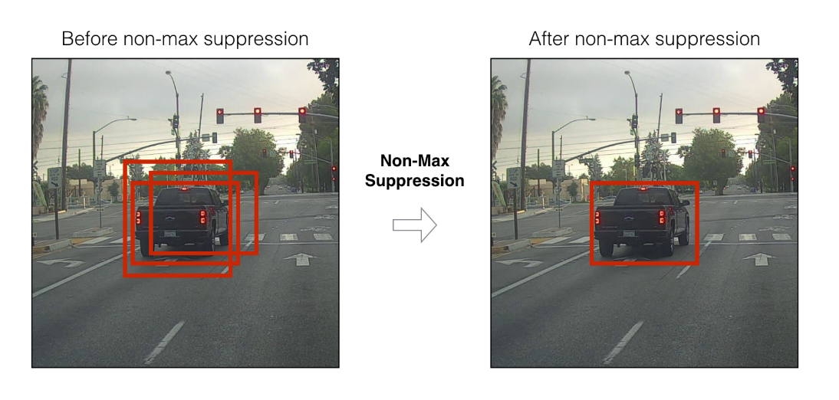
YOLO

Slide 8
PARAMETERS TO TRAIN AND TEST THE MODEL
TRAINING
TESTING
model: yolo_custom.cfg
train: True
load: 96876
epoch: 10
gpu: 0.8
save: 200
annotation: annotation
dataset: images
model: yolo_custom.cfg
load: 96876,
labels: labels.txt
imgdir: ../test_images
threshold:0.5
gpu:0.8

Slide 9
EXPERIMENTS
Training statistics:
Learning rate: 1e-05
Batch size: 6
Epoch number: 25
For final training: 3000 epochs
Time taken :50 hours
RMS prop
OPTIMIZER | INTIAL LOSS | LOSS
RMS PROP | 233.409 | 9.174627924582401
ADADELTA | 244.28654479980472 | 227
ADAGRAD | 233.5775146484375 | 163.78819392739558
ADAM | 258.9695739746094 | 13.979686690242735
SGD | 228.0630340576172 | 23.744057280813948

Slide 10
KEY FINDINGS
The loss reduced to about 4 and did not reduce further.
However, the detection confidence for the bounding boxes was greater than 0.8.
Some of the generated bounding boxes are not accurate.
Some objects are misclassified especially pipes and conduits. Signs are located accurately.

Slide 11
CONCLUSION
Errors could be possible due to errors in annotating the images.
Annotation needs to be carried out for many more images and with more precision and consistency.
Some objects are not identified but with more training it should be resolved.
A powerful GPU is required for training and to get quick predictions.
Using YOLO for identifying the object locations can save hours of manual work but requires more resources for training.

Slide 12
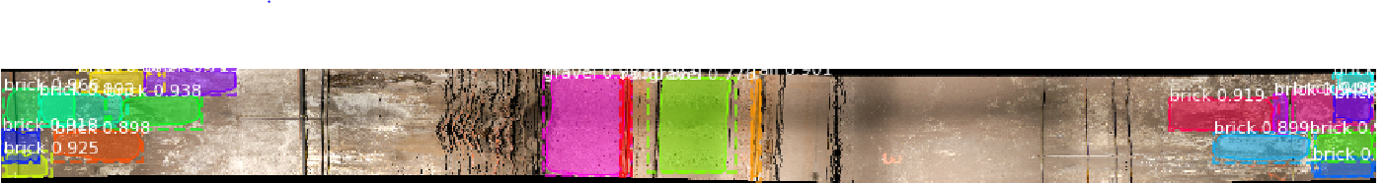
FUTURE WORK
The algorithm outputs a json file with the coordinates of every bounding box in an image, along with the class name.
These coordinates can then be used to identify the objects on the actual 3D model of the image which is created using the point cloud data.
Implement the Mask-RCNN algorithm to identify materials as well.

Slide 13
THANKYOU
RITIKA AGARWAL

